Slide 1
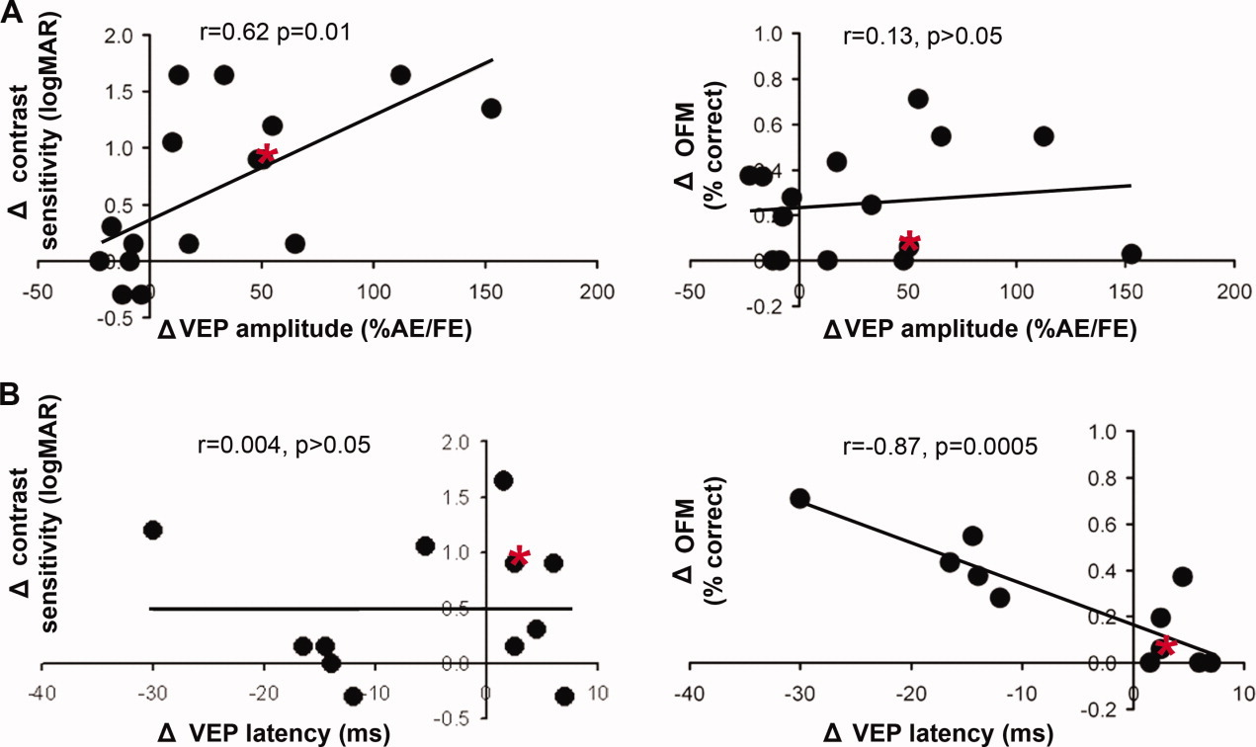
Demyelination affects temporal aspects of perception: An optic neuritis study
Annals of Neurology, Volume: 71, Issue: 4, Pages: 531-538, First published: 09 December 2011, DOI: (10.1002/ana.22692)
Notes:
Correlation between the changes in visual evoked potential (VEP) measurements and visual functions. Correlations between changes in VEP (A) amplitudes or (B) latencies and visual functions are shown for contrast sensitivity (left column) and object from motion (OFM; right column). Each symbol corresponds to 1 subject, indicating the delta between his acute and 4‐month phases (4‐month − acute scores). Asterisks denote 1 specific patient. His data are marked to demonstrate the reliance of contrast sensitivity improvement on VEP amplitude restoration and the insufficiency of this condition to accomplish dynamic visual functions. The patient's VEP amplitudes improved by 51% from the acute to the 4‐month phase (from 45 to 96%), and his VEP latency was elongated by 2.5 milliseconds (from 131 to 133.5 milliseconds). Correspondingly, his contrast sensitivity function improved by 0.9 units of logMAR, whereas a minimal improvement of 6% was evident in his OFM performance level. AE = affected eye; FE = fellow eye. [Color figure can be viewed in the online issue, which is available at annalsofneurology.org.]
IF THIS IMAGE HAS BEEN PROVIDED BY OR IS OWNED BY A THIRD PARTY, AS INDICATED IN THE CAPTION LINE, THEN FURTHER PERMISSION MAY BE NEEDED BEFORE ANY FURTHER USE. PLEASE CONTACT WILEY'S PERMISSIONS DEPARTMENT ON PERMISSIONS@WILEY.COM OR USE THE RIGHTSLINK SERVICE BY CLICKING ON THE 'REQUEST PERMISSIONS' LINK ACCOMPANYING THIS ARTICLE. WILEY OR AUTHOR OWNED IMAGES MAY BE USED FOR NON-COMMERCIAL PURPOSES, SUBJECT TO PROPER CITATION OF THE ARTICLE, AUTHOR, AND PUBLISHER.

